Slide 1
Team 3
Pat Besser, Shay McCarthy, Andrew Chinique, Austin Kim, Javier Diaz
MartinGarrixfans.com

Slide 2
Description
The website is dedicated to updating, informing, and connecting fans of Martin Garrix.

Slide 3
Functionality
Biography & Info tab - includes information, achievements, and rise to fame
Music tab - includes every single and all music he has been featured on
Media tab - Pictures and videos from tours, Music Videos, and Behind the Tracks.
Tour dates tab - include upcoming tour dates, have a section where fans can connect with each if they are going to the same concert, another section will have a place where fans can vote on where he goes next
Shop tab - all his merch will be here
Social tab - include feeds from various social media platforms

Slide 4
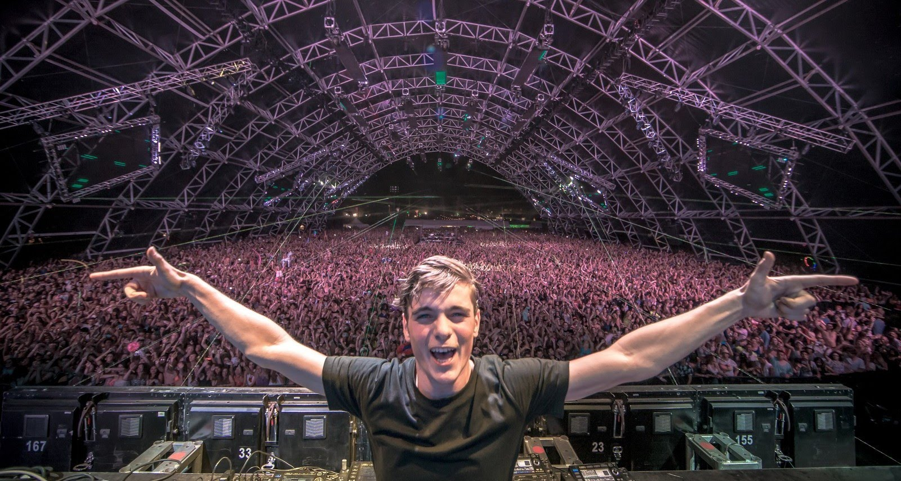
Martin Garrix
search
biography
music
media
tour dates
shop
social
Find out if he is coming near you soon!

